Slide 1
Wetlands Observer Mashkinonje Provincial Park email address: friendsofmashkinonje@gmail.com Vol 18 Issue 1 January 2018
In this Issue:
2 Bits & Bites
3 Annual Park Activities
4 FOM Renewal memberships
5 Happy Trails….
6 Canoe Raffle
7 Ontario Parks
8 Fun at the Park
9 FOM Board

Slide 2
Bits and Bites……..
David Anderson current owner of Lakair Lodge has pledged a donation to build a pavilion in memory of Kevin Cameron and his dedication to Mashkinonje Provincial Park. The pavilion would be located in the current picnic area at Loudon Peatland Trail. Our goal would be to have the structure in place for this summer. This donation is deeply appreciated.
Household garbage should be responsibly placed in waste disposal bins provided b the municipality and not irresponsibly dumped on Provincial Park property.
We continue to involve local youth in the Park and are hoping for participation again this year with the local High School. Planned student activities are to build new picnic tables, a hike led by Dr. Peter Beckett and discussions with Jeff Taylor owner of “Off the Ground”. This company has volunteered to take pictures/video of the Park using “Drone” technology.
Mark your calendars…..the Annual general meeting (AGM) is scheduled for 11:30 on Sunday August 19 at the main entrance on Hwy 64 – Loudon entrance. We will once again be holding a silent auction, selling canoe raffle tickets, renewing memberships, selling hats and providing a hot lunch for $10 per person (BBQ sausage, corn, salad, pop)
Winner of the 2017 canoe raffle is from Essex Ontario. Look for FOM selling canoe tickets once again in Noelville this summer at $5.00 each.
We would like to thank the following: Collins Barrow for completing our financial statements and tax returns. Trans Canada Trails donated $500 towards celebrating Canada’s 150th and the official opening of the portion of the Trans Canada Trail located within Mashkinonje Park at Blandings Access Point. RBC also donated $500 as a 2017 Volunteer Grant.
We will be supporting a local youth once again this year at the Ontario Nature Youth Summit to be held in September. It is a great opportunity to meet with other Youth in a leadership role learning about nature.
In 2017 we experienced flooding on the Loudon Trail at the bridge near the beaver pond. Last year there was exceptional rainfall amounts but FOM and Parks Ontario are planning to review the situation this spring after the snow melt.
The donation boxes and sign-in boxes are in place at the Loudon, Blandings and Martin Pond trailheads.

Slide 3
Annual Park Activities 2017/2018
Mark your 2018 Calendars
February 10 from 1-3 – Snowshoe Hike. Meeting at Loudon Peatland Trail.
May 11 – 9:30 to 1:00 – Annual Park Cleanup starting at Loudon Peatland Trail. Volunteers welcome.
May 26 from 9-12 – Annual Spring Hike. Meeting at Loudon Peatland Trail.
August 19 from 11:30 to 1:30 - AGM and BBQ held at Loudon Peatland Trail.
October 27 at 1:30 – Annual Hallowe’en Hike. Meeting at Loudon Peatland Trail.

Slide 4
Friends of Mashkinonje 2018 Membership
It is that time again to renew your annual membership as a Friend of Mashkinonje. Please complete the attached form and mail to the address below. Thank you ……we appreciate your support.
Respond to: Friends of Mashkinonje at 1692 Robin Avenue, Val Caron, Ontario P3N 1M3
www.mashkinonje.com
Please indicate the type of membership you would like to have. Memberships and donations are tax deductible and are much appreciated. YEAR_______________
Individual $15.00 _____________ Family $ 25.00 ______________ Corporate $50.00 _________________ Donation Only____________
I would like to become a sponsor in the following category: Muskrat Marsh $50.00_____________ Tamarac Swamp $100.00___________
Cotton Grass Fen $250.00 _________Moose Bog $500.00 ___________ Tax receipt desired___________________
Name: _________________________________________________________________________________________
Address:__________________________________________________________________________________
Email: _________________________________________________ Phone Number:________________________________
Thank you for being a Friend!

Slide 5
Happy Trails to You…..
Great options to hike with family and friends to obtain a different perspective of what is offered in Mashkinonje Provincial Park.
Samoset Trail (3.4km – Easy)
This trail is accessed through Blandings Access Point off of Hwy 64 and has a parking area. The trail takes you through jack pine forests, along granite ridges and across lowland red maple and black ash swamps. Be sure to take your binoculars and watch for waterfowl where the trail meets Samoset Creek. You may even see owls roosting in the dead tree stumps in the swamp.
Heron Trail (4.9km – Moderate)
This trail is accessed through Blandings Access Point off of Hwy 64 and has a parking area. Meander along rock ridges and take advantage of the many elevated lookouts. View bog species that have adapted to the special acidic conditions. Great bird watching opportunities exist along the entire route.
Pebble Beach Trail (3.4km – Difficult)
This trail is accessed through Martin Pond Access Point off of Musky Island Road (parking lot on the left hand side, small sign) or as a continuation of the Coastal Trail. There is also water access at Pebble Beach offering some docking and swimming facilities. The trail traverses bedrock ridges, winds through forests of jack pine, trembling aspen, red maple and red oak, giving you views of the West Arm of Lake Nipissing and Mashkinonje Island. The return portion is easier, allowing a gentle stroll along an old logging road.
Remember – Take appropriate clothing, food, water, navigational aids and a first aid kit when hiking or paddling. Protection from biting insects is recommended during spring and summer. Preserve our wetlands. Please stay on marked trails, keep pets on a leash, remove any litter, and leave plants and wildlife undisturbed. Do your best to ensure there are no adverse traces of your visit.

Slide 6
Canoe Raffle……. Draw October 2018

Slide 7
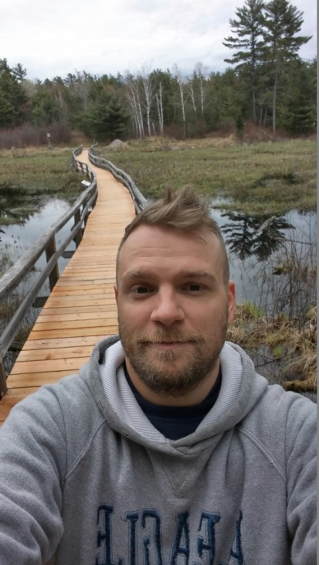
Parks Ontario
Bundle Up and Start the Celebrations!
What a winter so far! Mashkinonje is thoroughly frozen over, and if you bundle up, hiking and snowshoeing is a great way to spend a day outdoors, and can help to keep you warm and active in these cold temperatures.
Luckily, the animals living in Mashkinonje Provincial Park have lots of tricks to stay warm. Frogs hibernate for the winter by slowing their heartbeats and dropping their body temperature. Turtles stay underwater below the ice and although they are awake and alert, their metabolism slows right down to a point where they barely move. Mammals such as deer and beavers grow a thick coat of fur to keep the cold out and develop an extra layer of fat to add some insulation. Fortunately for us humans, we don’t need to freeze our bodies like the frogs or develop an extra layer of fat to enjoy a hike at Mashkinonje (although some might say the extra layer appears after Christmas and a nice hike is a means to whittle it down!).
If you are heading out to enjoy the trails in Mashkinonje this winter, always prepare for all types of weather. Make sure you have sturdy, waterproof boots with some thick wool socks. Layer your clothes, and wear moisture-wicking materials like wool or polyester, which help to keep heat in. Avoid cotton as a base layer while doing physical activity outside - it absorbs moisture and will keep you cold. Bring lots of water and snacks, and things like hand-warmers and first aid kits will help you be more prepared as well. Once you are warm and ready to go, don’t forget to bring a friend and a camera for your hike!
Now that you’re all warmed up, let’s start the party – Ontario Parks is celebrating its 125th birthday this year! Starting with the designation of Algonquin Provincial Park in 1893, the Ontario Parks system has developed into a work-renowned organization. It’s a very exciting year full of activities and celebrations and I encourage you to check out the Ontario Parks Website to see what events might be happening at Parks in the area.
Last but not least, I’d like to put the spotlight on one person in particular who has went above and beyond for Mashkinonje Provincial Park this last year. Tom Viola, a resident of Monetville, contacted Ontario Parks in Spring 2017 looking for any ways he could volunteer around the parks in the area. Well, we will never say no to an eager volunteer in Ontario Parks!
Tom started his volunteering right away at the Loudon access point by picking up garbage on the trails , in the day-use and parking areas on a regular basis. In early summer Tom helped Ontario Parks staff and Sudbury Fire crews put in the docks at Pebble and Lapin Beaches. Tom continued to help at other Provincial Parks in the area and was always a great asset to the team, no matter what the task was. Ontario Parks would like to recognize and commend Tom for dedicating his time to keeping our trails at Mashkinonje clean, safe and enjoyable. Thank you Tom!
See you on the trails!
Jessica Smith
Assistant Park Superintendent
Mashkinonje Provincial Park

Slide 8
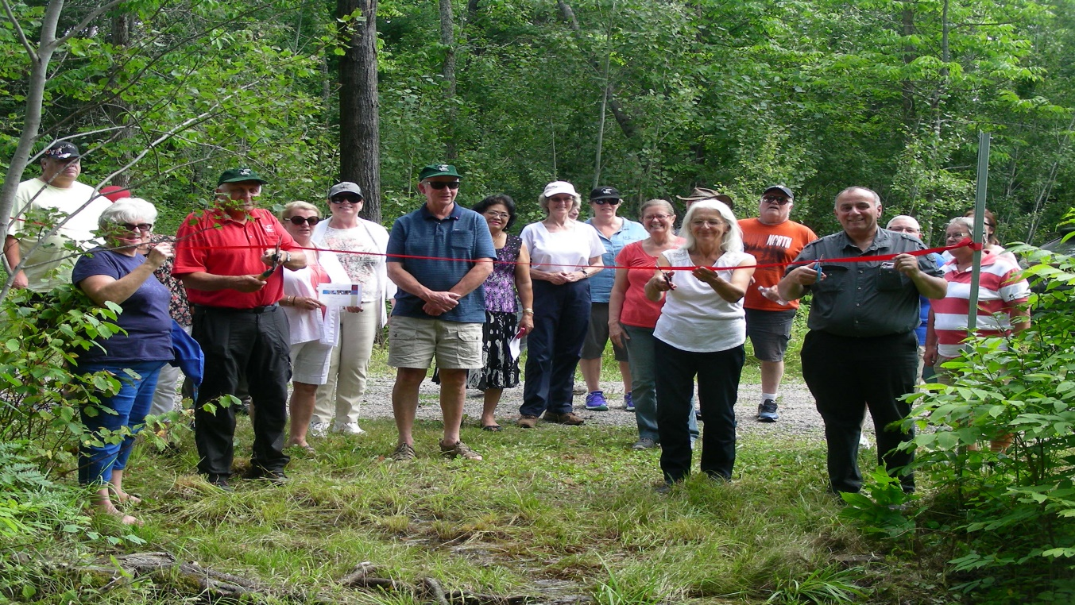
Fun at the Park August 2017 AGM and official opening of our portion of the Trans Canada Trail

Slide 9
2017-2018 Board of Directors
President: Peter Beckett
Vice President: Mary Tallevi
Treasurer/Membership: Brenda Tunney
Secretary: Mary Coulombe
Honorary Board Member: Harley Lang
ONTARIO PARK REPRESENTATION:
Superintendent Parks Ontario Jeremy Pawson
Assistant Superintendent Jessica Smith
CONTACT INFORMATION:
Internet: www.mashkinonje.com
Email: friendsofmashkinonje@gmail.com
Facebook www.facebook.com/friendsofmashkinonje
Mail: Friends of Mashkinonje
1692 Robin Avenue, Val Caron, Ontario P3N 1M3 ,
Faceboo

